Slide 1

Social Desirability Bias and Engagement in Systems Designed for Long-Term Health Tracking
Laura Vardoulakis
College of Computer and Information Science
Ph.D. Defense
March 28, 2013

Slide 2
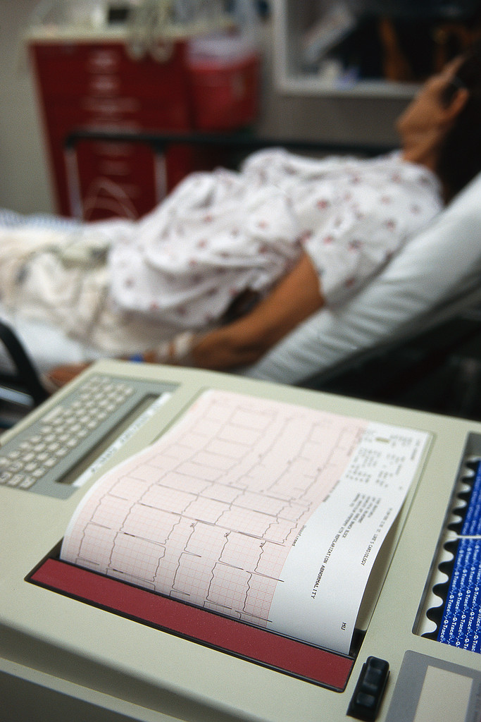
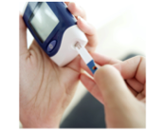
Prevalence of Chronic Disease
Heart disease affects 26.5 million adults in the U.S.
CDC, 2011
Diabetes now affects 9% of US adults.
CDC, 2011
Medical costs associated with obesity
$147,000,000,000 per year
Finkelstein, et.al, 2009

Slide 3
Primary care offices are overbooked and patients get only minutes with their physician.
Bodenheimer et al, 2002
Ostbye et al, 2005

Slide 4

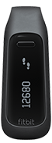
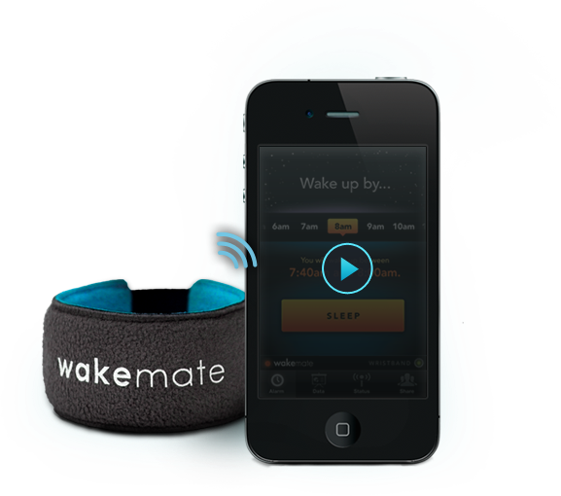
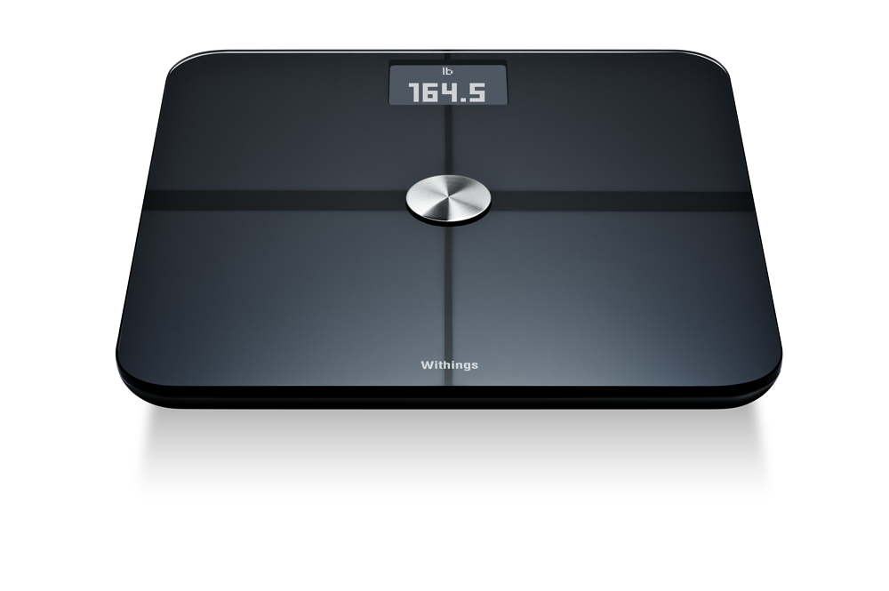
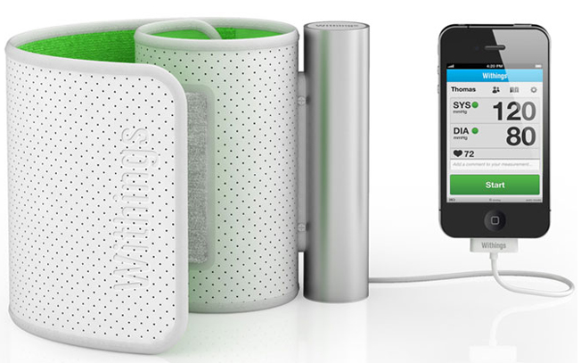

Slide 5
Self-tracking has health benefits
Better weight-loss outcomes
Spring, et.al, 2013
More patient involvement
40% asked their doctors new questions or sought second opinions.
46% changed their overall approach to health
Fox and Duggan, 2013

Slide 6
Current Challenges
Not everything can be tracked with a sensor.
How are you feeling?
Are you experiencing any pain?
Any problems with your prescriptions?

Slide 7
In this thesis, I ask two research questions:
How do we design a system to maximize the quality of self-reported data?
How do we keep people engaged with such a system, over potentially long periods of time?

Slide 8
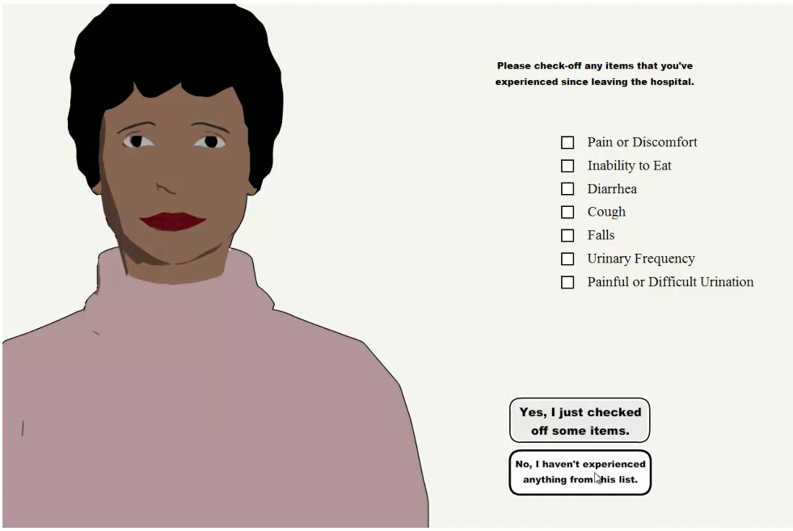
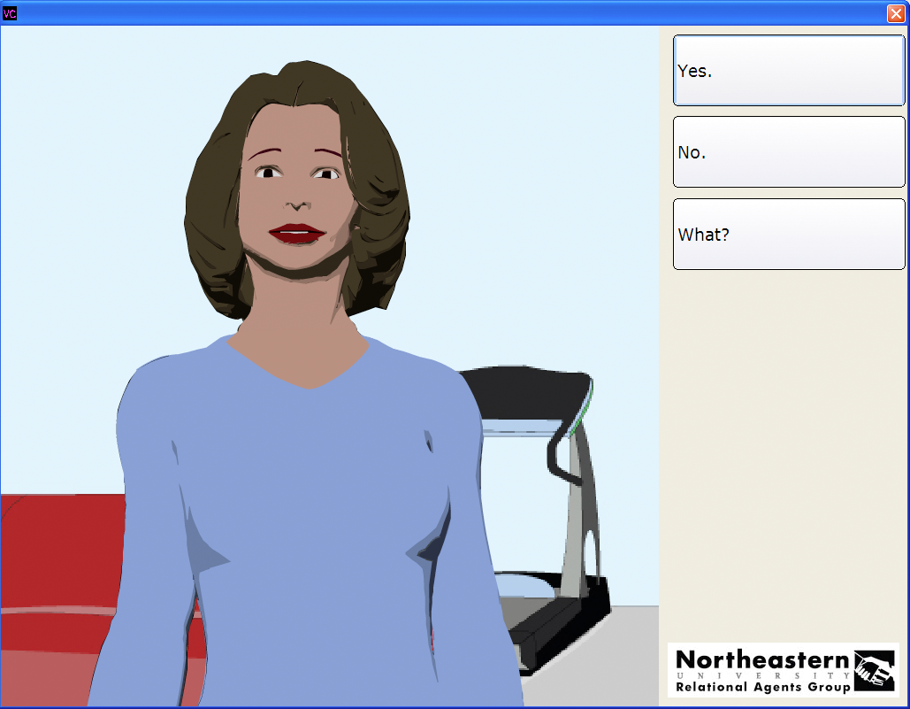
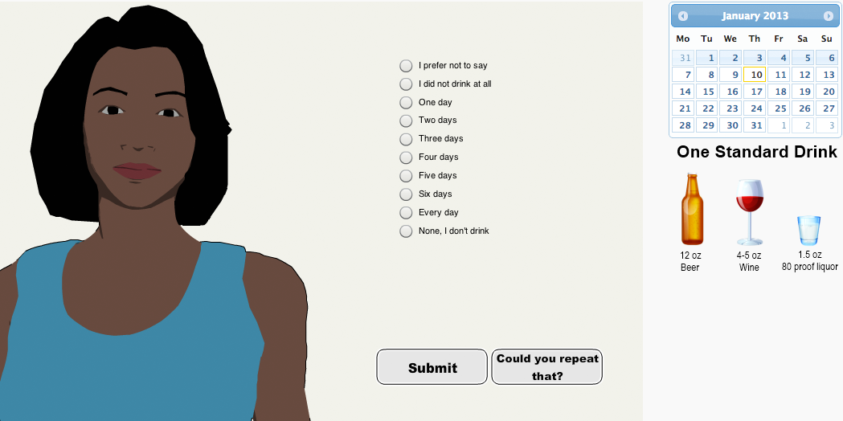
MyLink2Care
Exercise Promotion
The Drinks Project

Slide 9
Contributions
Post-hospitalization system design
Patient observations
Field trial – challenges with system use

Slide 10
Contributions
Social reactions to computers are dynamic
Social desirability bias changes with interface presentation

Slide 11
Contributions
Time trumps incentives
Tailored health messages might reduce self-reported data quality

Slide 12
Contributions
Rather than providing analysis on a single time-variable or even pre-post data, the analysis of these systems focuses on change over time.

Slide 13
MyLink2Care
Exercise Promotion
The Drinks Project
Notes:
Today, I'll be talking briefly about our system for exercise promotion, and mostly about our experiment with the system designed for tracking alcohol consumption.

Slide 14
Background and Related Work

Slide 15

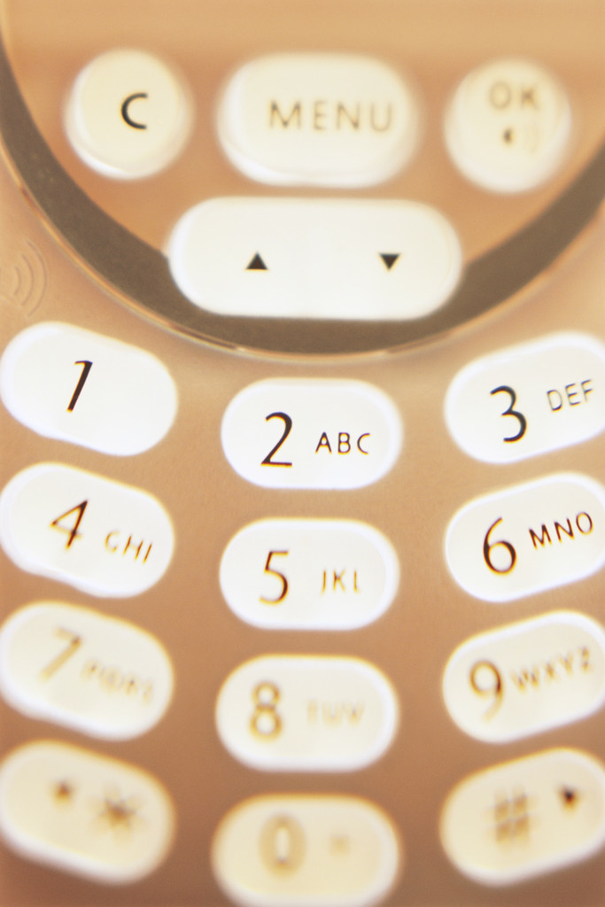



Self-Report
Anonymity

Slide 16
Self-report gets a bad rap People question its accuracy Sensor data is preferred

Slide 17
Social Desirability Bias
The tendency of an interviewee or questionnaire respondent to put themselves in a favorable light with respect to social norms
Crowne & Marlowe ‘64

Slide 18

Face-to-face communication is often
considered best.
But what about sensitive topics?
Paper-Pencil might be better.
(Fairburn & Beglin, 1994)
Computers might be even better.
(Booth-Kewley et al, 2007, Newman et al, 2002 )

Slide 19
A Dilemma

Slide 20
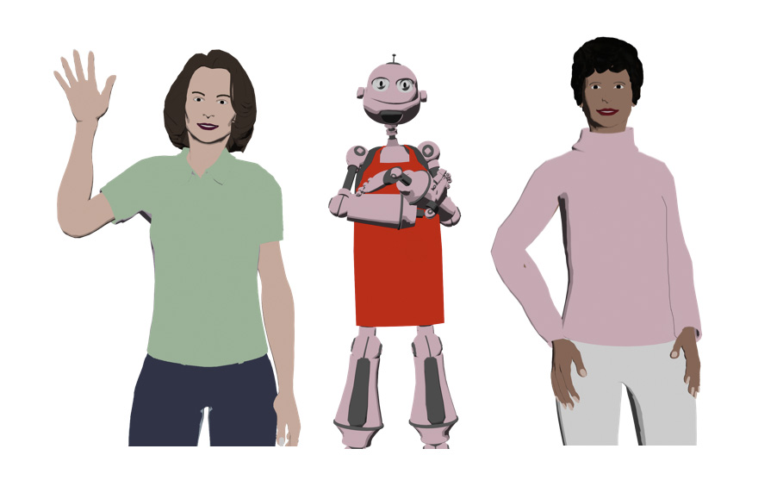
Embodied Conversational Agents

Slide 21

Background: Social Reponses to Computers
Politeness
Nass, Moon & Carney, ’99
Takayama, Groom, Nass, ‘09
Flattery
Reeve & Nass, ‘97
Gender attributes
Nass, Moon & Green, ‘97

Slide 22
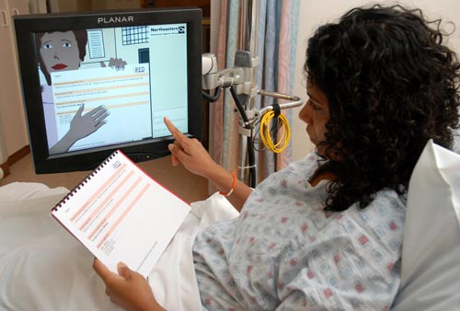

Slide 23
“I prefer Louise, she’s better than a doctor, she explains more, and doctors are always in a hurry.”
“She tells me more than my doctor does.”
“She treated me like a real person! She’s not like a computer. This is awesome work! This is really excellent.”
“Sometimes doctors just talk and assume you understand what they’re saying. With a computer you can go slow, go over things again and she checks that you understand.”

Slide 24
“I prefer Louise, she’s better than a doctor, she explains more, and doctors are always in a hurry.”
“She tells me more than my doctor does.”
“She treated me like a real person! She’s not like a computer. This is awesome work! This is really excellent.”
“Sometimes doctors just talk and assume you understand what they’re saying. With a computer you can go slow, go over things again and she checks that you understand.”

Slide 25
ECA’s have potential
Can they collect
self-reported health data?
How will people
react to them over time?

Slide 26
Experiment I
Self-reported data quality and changes over time

Slide 27
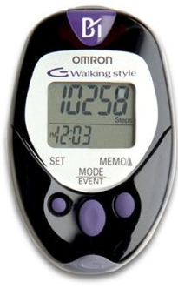
Study Design
Daily chat with a virtual exercise counselor

Slide 28
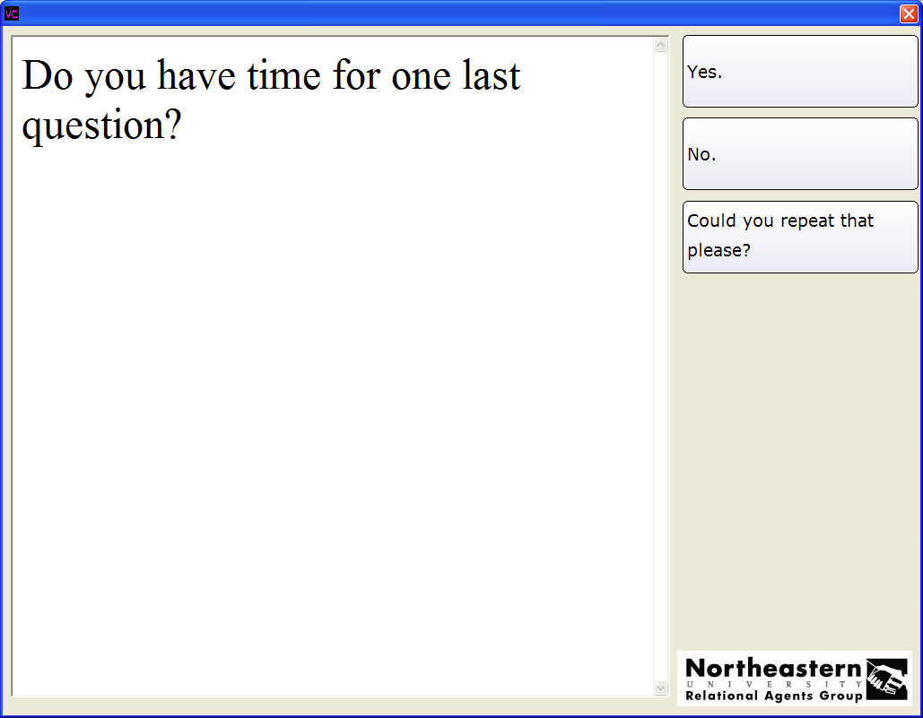
Do you have time for one last question?

Slide 29
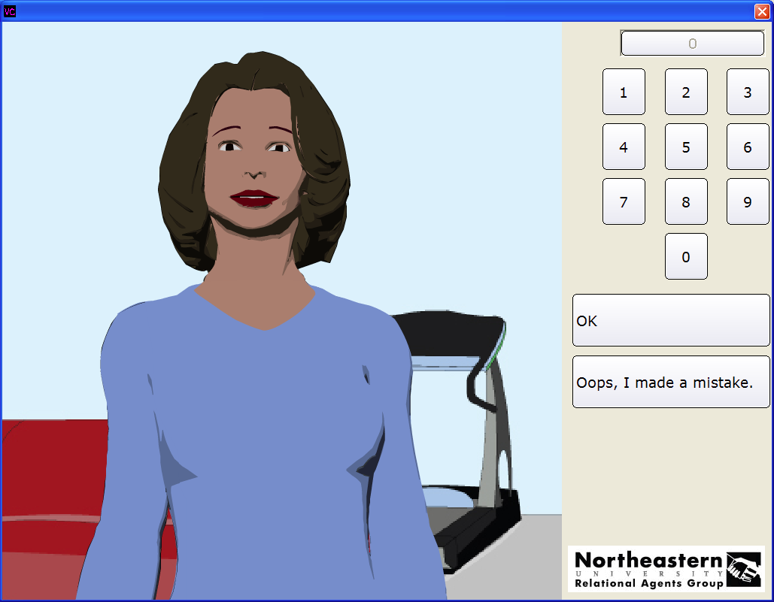
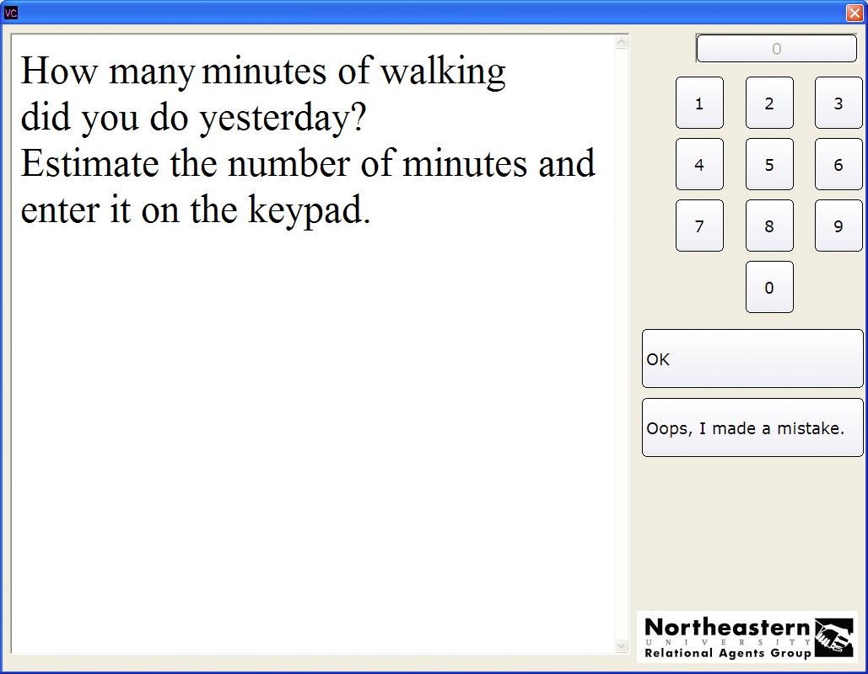
Estimate time spent walking

Slide 30
Participants
25 people (23 women)
Ages 55-68
$1/day, 6-week long study

Slide 31
Research Question 1
Given a participant's walking behavior on day n, what’s the likelihood they will use the system
on day n+1?

Slide 32
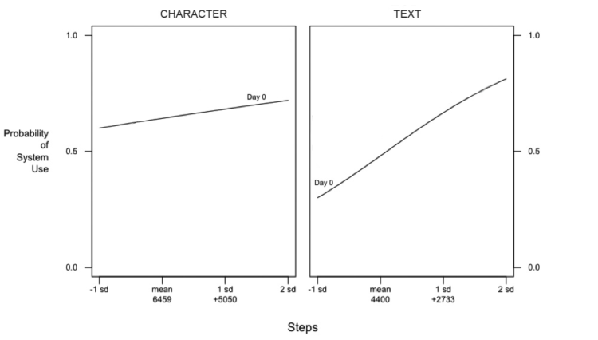
Notes:
Here’s what we saw for both groups. The Y axis shows the probability that a participant uses the system on a given day. And the X axis shows the number of steps that they took, so their pedometer readings, from the previous day. For this analysis we’re using a Logisitic Mixed-Effect regression model, that suitable for binary outcomes: whether they used the system on a given day, or not.

Slide 33
Notes:
This line shows the probability of using the system at the beginning of the study. So, for our groups, the walking behavior of those in the TEXT condition had a greater effect on whether or not they chose to use the system on the following day. If they didn’t walk, they were less likely to use the system, and if they walked a lot, they were more likely to use the system.

Slide 34
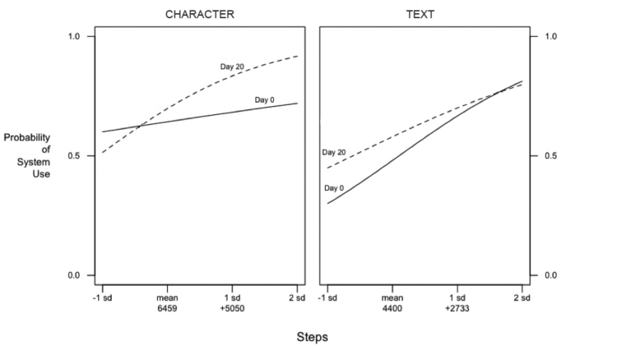
Notes:
At day 20, we start to see the walking behavior become less of a factor for the TEXT condition – their line becomes less steep, and it starts to becoming stronger for those in CHARACTER condition

Slide 35
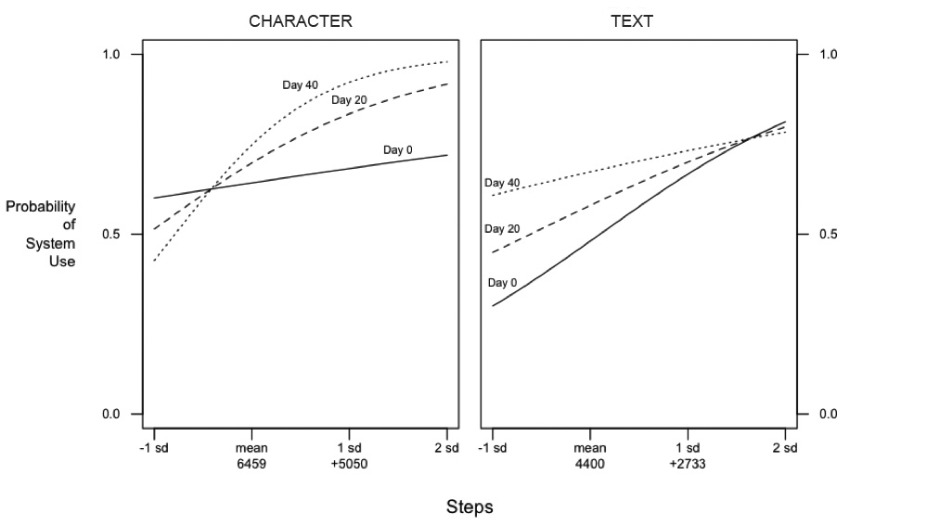
Notes:
And by the end of the study at day 40 , we the effect of walking behavior is a very strong factor for those in the character condition, choosing to use the system or not. And for TEXT the effect almost goes away completely.

Slide 36
Results
For both conditions, the more they walked, the more likely they were to use the system.
Over time, this effect increased for those interacting with the AGENT interface, and decreased for those interacting with the TEXT interface.
β = -0.0422, p = 0.014

Slide 37
Research Question 2
If a participant did use the system, what’s the likelihood that they reported their time walking ?

Slide 38
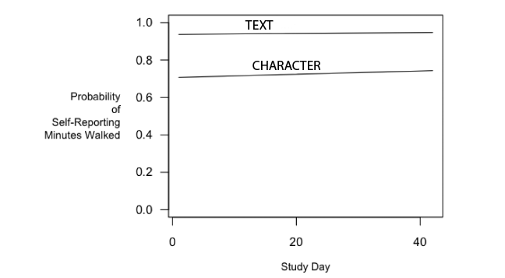
Probability of Self-Reporting
β = 1.817, p < 0.01

Slide 39
Research Question 3
If a participant did self-report their time spent walking, how accurate was that data?

Slide 40
Results: Self-Reported Data Quality
AGENT: r = 0.75, p < 0.001; [95% CI, 0.69-0.81]
TEXT: r = 0.50, p < 0.001; [95% CI, 0.40-0.59]

Slide 41
Contributions
Social responses to computers are not static, but change over time.
ECA’s may have a positive effect on data quality, but a negative effect on engagement.
(Pfeifer and Bickmore, CHI 2011)

Slide 42
Experiment II – The Drinks Project Incentives and Engagement Over Time

Slide 43
Incentives
Social Exchange Theory (Homans, 1958 & 1974)
Our social interactions and relationships may be considered as an exchange of goods
Behavioral Economics (Loewenstein, et al, 2007, Volpp et al 2008 & 2009)
Doesn’t assume that decisions are always made rationally
Tailored Health Messages (Hawkins, et al, 2008)
The more personal the message, the greater the impact.

Slide 44
Alcohol Consumption

Slide 45
Alcohol and Health
Death: 1,825 college students die from alcohol-related unintentional injuries, including motor vehicle crashes per year.
Injury: 599,000 students are unintentionally injured under the influence of alcohol.
Assault: 696,000 students are assaulted by another student who has been drinking.
Sexual Assault: 97,000 students are victims of alcohol-related sexual assault or date rape.
(Hingson et al., 2009)

Slide 46
Study Design
Eligibility: Northeastern Students, 18+
Recruitment: Flyers, handouts, email, newspaper
Enrollment: Online
Frequency: Once a week, up to 28 questions
Length: 4 months
IRB# 10-08-04

Slide 47
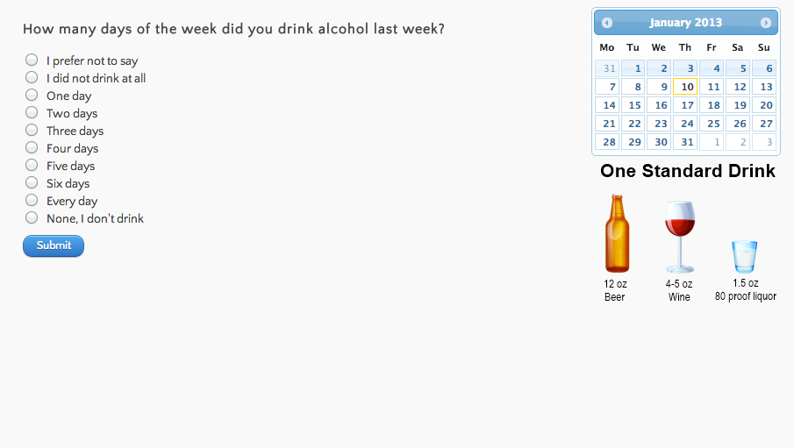
Study Design
Agent Text

Slide 48
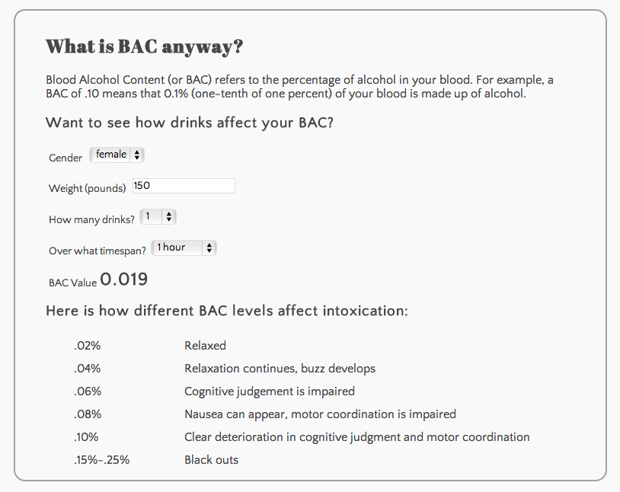
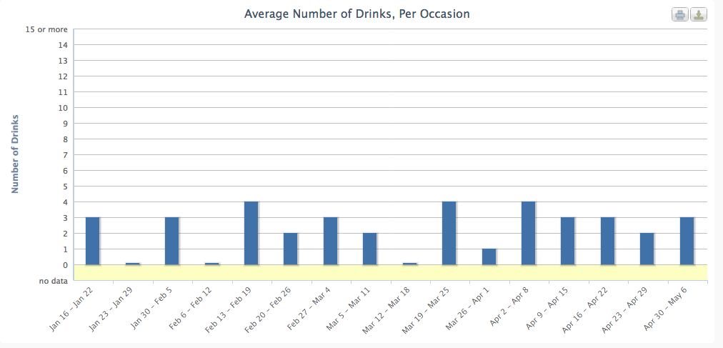
Study Design
Personalized Feedback No Feedback

Slide 49
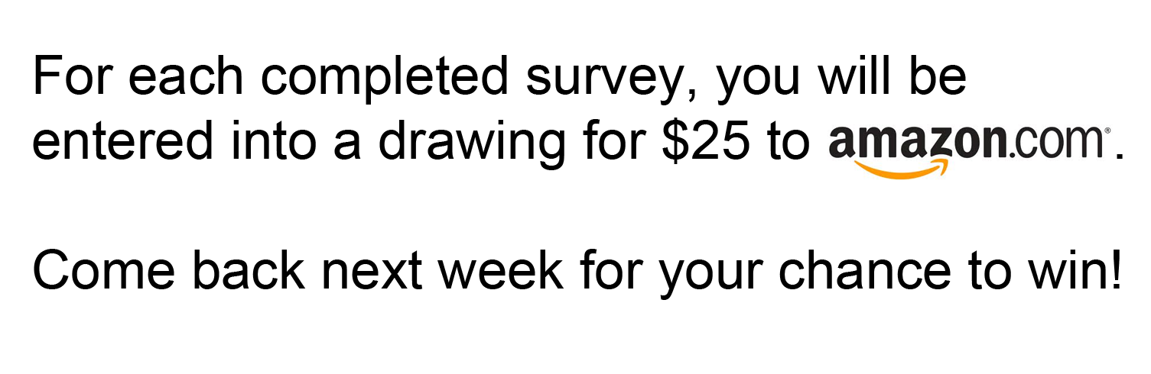
Study Design
Monetary Incentive Reminders No Incentive Reminders

Slide 50
Study Design
Independent Variables
Dependent Variables
Interaction mode
Agent/Text
Monetary Incentive
Reminder/No-Reminder
Personal Incentive
Feedback/No-Feedback
Number of Interactions
Agent/Text
Alcohol Disclosure
Alcohol Consumed
Negative Consequences
Protective Behaviors
Attitudes towards the system
2 x 2 x 2 Between-Subjects, Experimental Design

Slide 51
Weekly Questionnaire
Alcohol Consumption
Think of the occasion you drank the most last week. How much did you drink?
Negative Consequences
How many times did you attend class hung over or were unfocused in class?
Protective Behaviors
How often did you switch between alcoholic and non-alcoholic drinks?

Slide 52


Slide 53
Results

Slide 54
Participants
Women | 249
Men | 126
Freshman | 103
Sophomore | 69
Middler | 50
Junior | 39
Senior | 62
Grad Student | 52
Ages 18-20 | 206
21-23 | 134
24+ | 35

Slide 55
Engagement over time
Week | Completed Surveys | %
1 | 302 | 81
2 | 118 | 31
3 | 119 | 32
4 | 98 | 26
5 | 76 | 20
6 | 71 | 19
7 | 72 | 19
8 | 68 | 18
9 | 59 | 16
10 | 55 | 15
11 | 43 | 11
12 | 39 | 10
13 | 35 | 9
14 | 39 | 10
15 | 21 | 6
16 | 18 | 5

Slide 56
Which groups had the most total sessions?

Slide 57
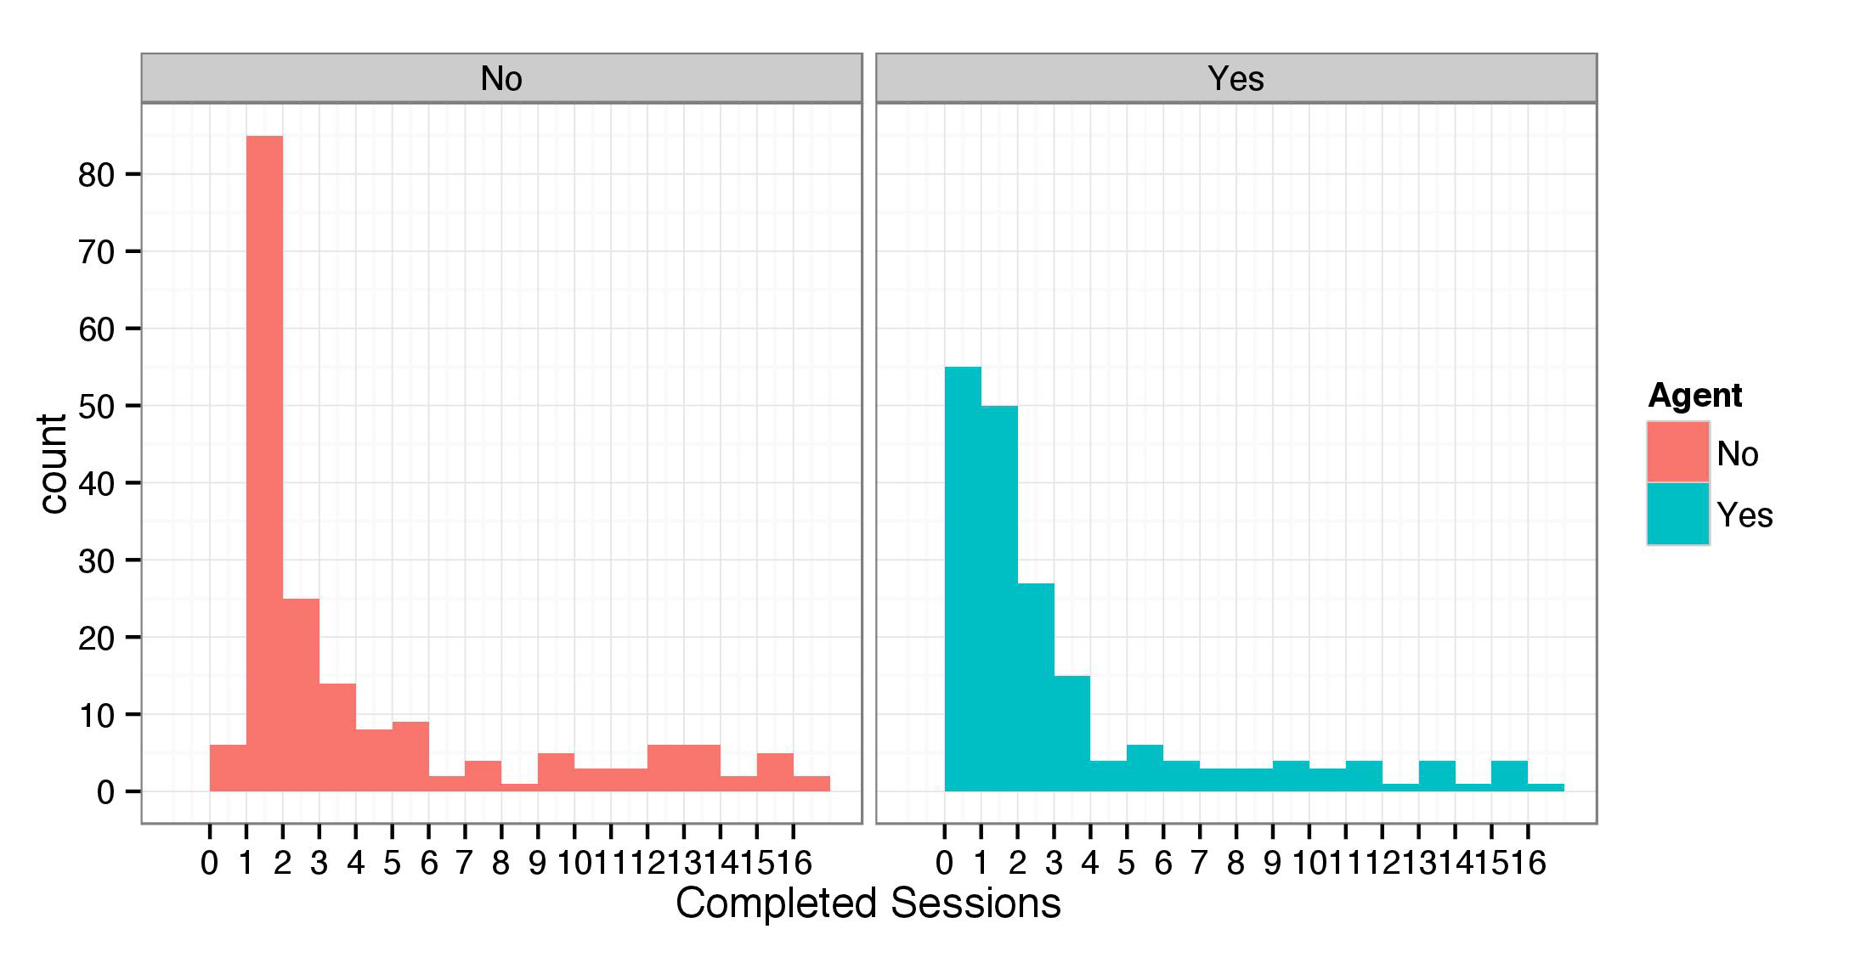
Text Interface – Agent Interface

Slide 58
Interface Presentation
Average number of sessions
Text 3.74 (sd = 4.27)
Agent 2.79 (sd= 3.86)
Time needed to complete a session (seconds):
Text 218.18 (sd = 121.73)
Agent 246.63 (sd = 125.45)
We can model this with a Negative Binomial Regression, and account for time needed to complete the survey.

Slide 59
Results
For each second increase in the time needed to complete the survey, the AGENT participants had a lower rate of completion than the TEXT participants.
incidence rate ratio, 0.994 [95% CI, 0.996 to 0.999], p=0.0190

Slide 60
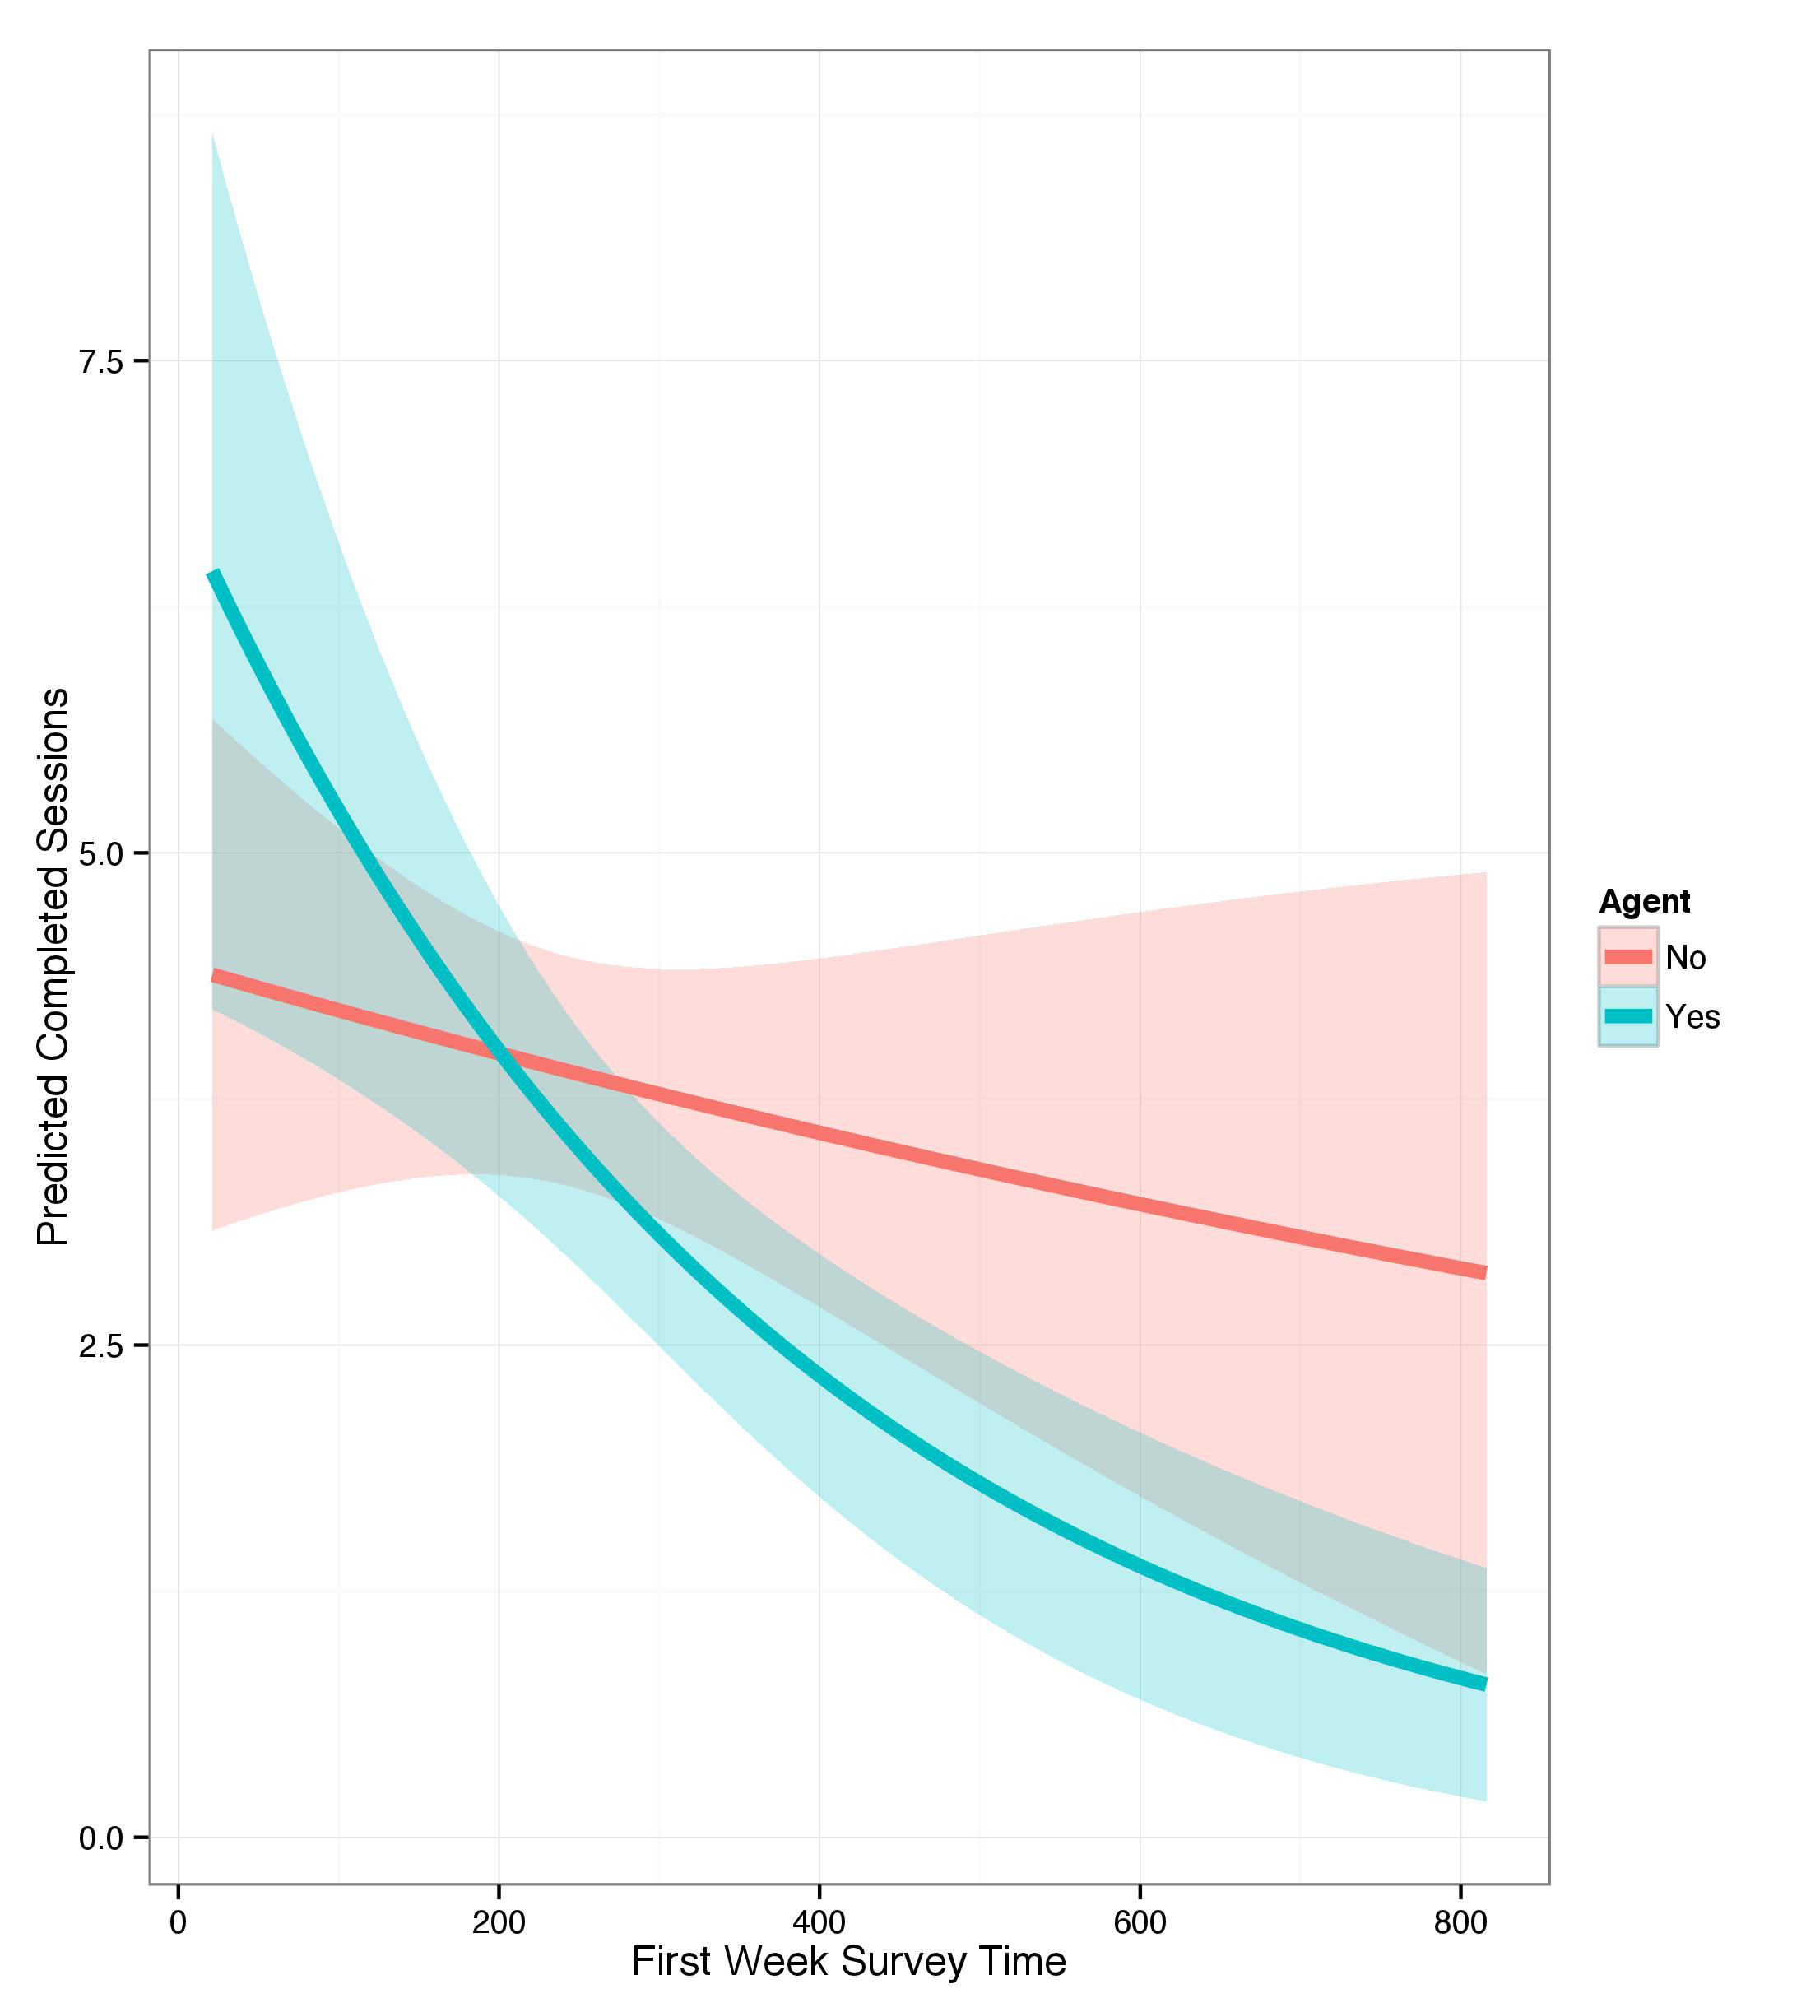
Predicted total sessions
incidence rate ratio, 0.994 [95% CI, 0.996 to 0.999], p=0.0190

Slide 61

Incentives
No effect of personalized feedback nor monetary incentive reminders on total number of sessions.

Slide 62
What about relevance?
drinkers vs. non-drinkers

Slide 63
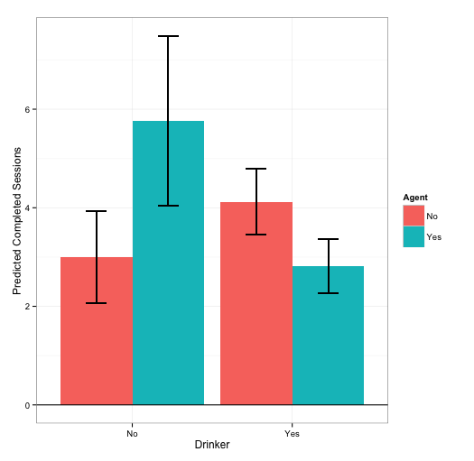
Predicted sessions, by drinker/non-drinker

Slide 64
Is this just a proxy for time/effort?

Slide 65
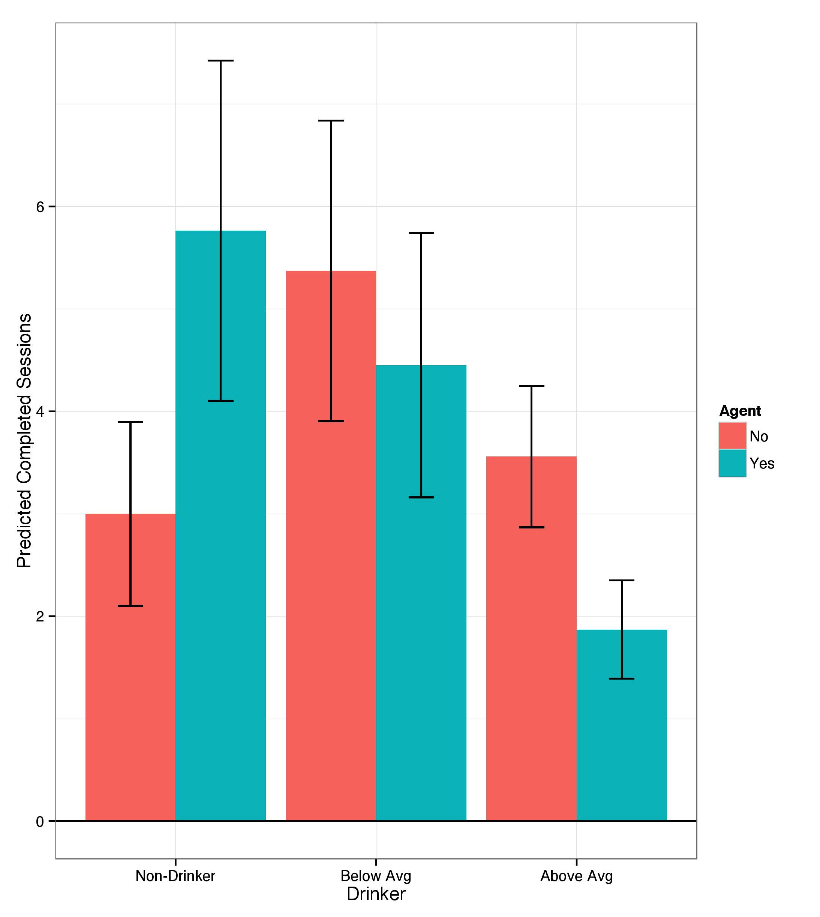
Predicted sessions, by drinker type

Slide 66
How did engagement change over time?

Slide 67
What predicts longitudinal change in engagement?
Drinker status
Time needed for interaction

Slide 68
Likelihood of a participant completing the survey diminishes with time.
β₁ = -0.4284, [95% CI, -0.5334 to -0.3234], p < 0.001
Below-average drinkers have a higher likelihood of completing the survey over non-drinkers and that this effect remains consistent over time.
β₂ = 2.3342, [95% CI, 0.9626 to 3.7058], p < 0.001
Those who experienced above average times to complete the survey during the first week, had consistently lower completion rates than participants who experienced below average times needed to complete the survey during the first week.
β₄ = -1.2833, [95% CI, -2.3592 to -0.2073], p < 0.05

Slide 69
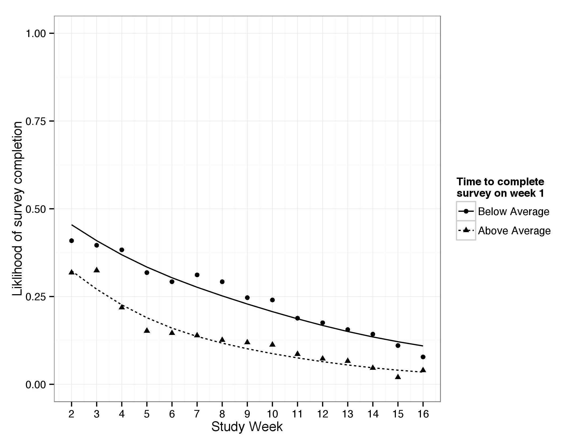
Time as a longitudinal predictor
β₄ = -1.2833, [95% CI, -2.3592 to -0.2073], p < 0.05

Slide 70
Self-Reported Alcohol Use

Slide 71
Week 1
How many days of the week did you drink alcohol last week?
The number of days was lower for the FEEDBACK group (m= 1.29) versus the NO-FEEDBACK group (m = 1.59), F(1, 311) = 3.702, p = 0.055
Notes:
HERE, WE’RE JUST LOOKING AT WEEK 1. Recall that completion rates declined significantly after week 1, so let’s start there
And this was BEFORE they even saw any feedback. But RIGHT AFTER they were told about the feedback for the first time.

Slide 72
Week 1
How many drinks per occasion do you consider moderate (not excessive) for yourself?
The number of drinks was lower for the AGENT group (m= 3.79) versus the TEXT group (m = 4.15), F(1, 282) = 4.127, p < 0.05

Slide 73
Changes in self-report over time
Negative Consequences
Those in the FEEDBACK group consistently reported a lower number of negative consequences then those in the NO-FEEDBACK group
β₂ = -0.061, [95% CI, -0.109 to -0.011]
Notes:
CAVEAT – underpowered, interpret as pilot data

Slide 74
Changes in self-report over time
Protective Behaviors
As the study progressed, the AGENT group reported taking more protective behaviors over time, compared to the TEXT group.
β₃ = 0.099, [95% CI, -0.016 to 0.215]

Slide 75
Participants’ thoughts on their experience
Notes:
Fifty-eight participants (15.47%) completed the follow-up questionnaire.
No differences in feelings of confidentiality of anonymity.

Slide 76
Thinking back, how honest were your answers to the weekly survey questions?
Participants in the TEXT condition reported being more honest than those in the AGENT condition (5.85 vs. 5.4).

Slide 77
Personalized feedback and self-presentation
You filled out the survey __ times. What made you come back and fill it out several times?
“[I wanted] to average out the data. Some weeks I did drink a lot on the weekends, when other weeks I did not at all. I am almost always responsible with my drinking habits.”
“I made a commitment to fill it out every week. Even if no one else was holding me to that commitment, I was.”

Slide 78
The Drinks Project Conclusions
Time and relevance best predict longitudinal use
(no effect of incentives on longitudinal use!)
Feedback group had higher rates of social desirability bias

Slide 79
Research Contributions

Slide 80
Research Contributions
Social reactions to computers are not static, but change over time.
Interface presentation affects self-reported data quality.
Feedback and reflection may negatively impact data quality.
Time and effort predict future use, more than incentives.

Slide 81
Future work
Self-trackers
Non-trackers

Slide 82
Thank You
Laura Vardoulakis
laurap@ccs.neu.edu

